Slide 1
3
Applications of Differentiation
Copyright © Cengage Learning. All rights reserved.

Slide 2
Topics for this week
L’Hospital’s Rule
Rolle’s Theorem and Mean Value Theorem
Newton’s Method

Slide 3
L’ Hospital’s Rule
Copyright © Cengage Learning. All rights reserved.

Slide 4

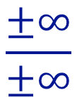





Indeterminate Forms
$$\frac{0}{0}$$
$$\frac{±∞}{±∞}$$
$$0∙\left(±∞\right)$$
$$0^{0}$$
$$1^{±∞}$$
$$∞^{0}$$
$$∞−∞$$

Slide 5
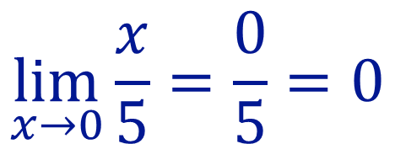

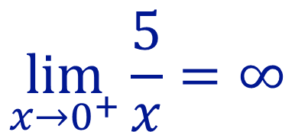
Indeterminate Form
$$\frac{0}{0}$$
$$\lim_{x→0}{\frac{x}{5}=\frac{0}{5}=0}$$
$$\lim_{x→0^{+}}{\frac{5}{x}=∞}$$

Slide 6
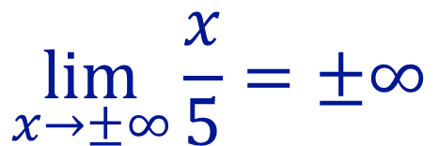

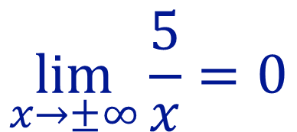
Indeterminate Form
$$\frac{±∞}{±∞}$$
$$\lim_{x→±∞}{\frac{x}{5}=±∞}$$
$$\lim_{x→±∞}{\frac{5}{x}=0}$$

Slide 7


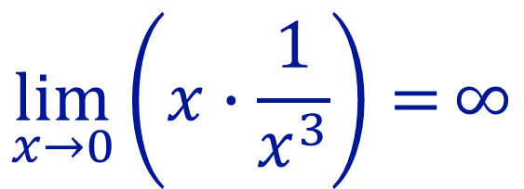
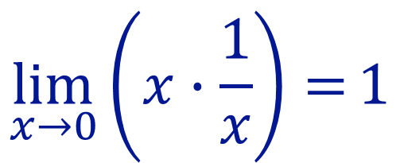
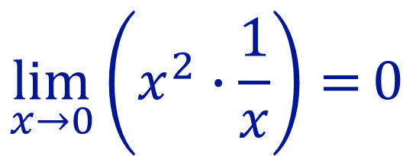





Indeterminate Form
$$0∙\left(±∞\right)$$
$$0$$
$$\left(±∞\right)$$
$$0$$
$$\left(±∞\right)$$
$$\lim_{x→0}\left(x^{2}∙\frac{1}{x}\right)=0$$
$$\lim_{x→0}\left(x∙\frac{1}{x}\right)=1$$
$$0$$
$$\left(+∞\right)$$
$$\lim_{x→0}\left(x∙\frac{1}{x^{3}}\right)=∞$$

Slide 8

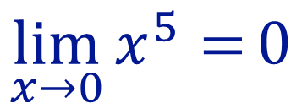

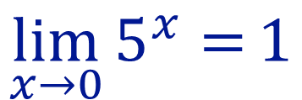

Indeterminate Form
$$0^{0}$$
$$0$$
$$0$$
$$\lim_{x→0}{x^{5}=}0$$
$$\lim_{x→0}{5^{x}=}1$$

Slide 9
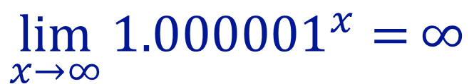
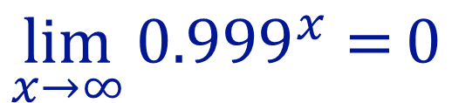

Indeterminate Form
$$1^{±∞}$$
$$\lim_{x→∞}{{0.999}^{x}=}0$$
$$\lim_{x→∞}{{1.000001}^{x}=}∞$$

Slide 10
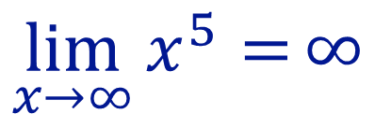

Indeterminate Form
$$∞^{0}$$
$$\lim_{x→∞}{x^{5}=}∞$$
$$\lim_{x→0}{5^{x}=}1$$

Slide 11



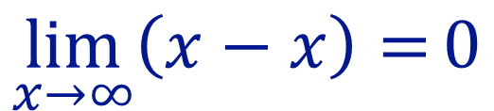


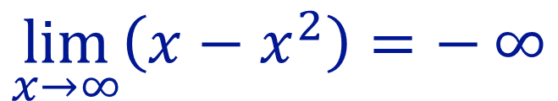
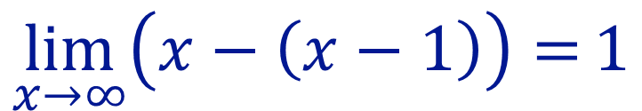
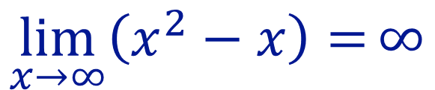
Indeterminate Form
$$∞−∞$$
$$∞$$
$$∞$$
$$\lim_{x→∞}\left(x−x\right)=0$$
$$\lim_{x→∞}\left(x^{2}−x\right)=∞$$
$$∞$$
$$∞$$
$$\lim_{x→∞}\left(x−x^{2}\right)=−∞$$
$$\lim_{x→∞}\left(x−\left(x−1\right)\right)=1$$

Slide 12
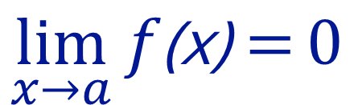
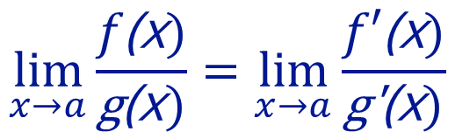

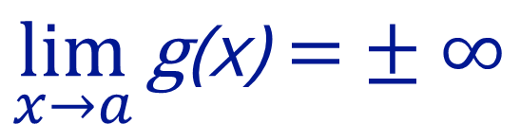
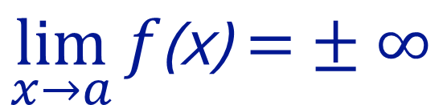
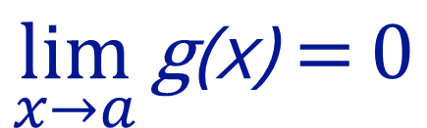
L’ Hospital’s Rule
Suppose f and g are differentiable and$g^{′}\text{(}\text{x}\text{)}≠0 \text{on} \text{an} \text{open} \text{interva}\text{l} \text{l} \text{that} \text{contains} \text{a}\text{. }\text{Supp}\text{o}\text{se} \text{that}$
$$\lim_{x→a}{f\text{(}\text{x}\text{)}=}0$$
and
$$\lim_{x→a}{\text{g}\text{(}\text{x}\text{)}=}0$$
$$\lim_{x→a}{f\text{(}\text{x}\text{)}=}±∞$$
and
$$\lim_{x→a}{\text{g}\text{(}\text{x}\text{)}=}±∞$$
Or that
$$\lim_{x→a}{\frac{f\text{(}\text{x})}{\text{g}\text{(}\text{x})}=\lim_{x→a}{\frac{f′\text{(}\text{x})}{\text{g}\text{′}\text{(}\text{x})}}}$$
Then

Slide 13
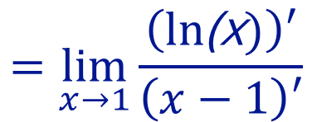
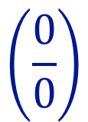
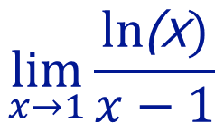

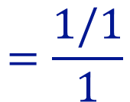
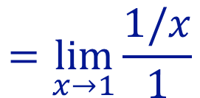
Example 1
$$\lim_{x→1}{\frac{ln\text{(}\text{x})}{x−1}}$$
$$=\lim_{x→1}{\frac{\left(ln\text{(}\text{x})\right)′}{\left(x−1\right)′}}$$
$$\left(\frac{0}{0}\right)$$
$$=\lim_{x→1}{\frac{1/x}{1}}$$
$$=\frac{1/1}{1}$$
$$=1$$

Slide 14
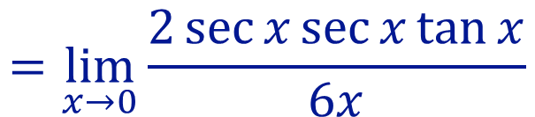
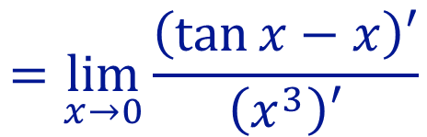
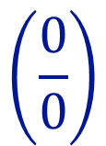
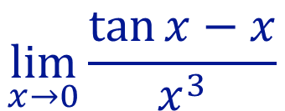
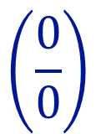

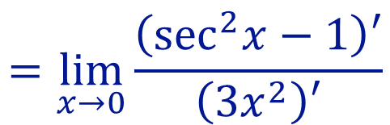
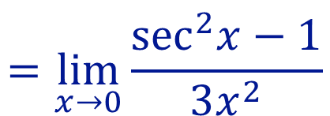
Example 2
$$=\lim_{x→0}{\frac{\left(\tan{x}−x\right)′}{\left(x^{3}\right)′}}$$
$$\left(\frac{0}{0}\right)$$
$$\lim_{x→0}{\frac{\tan{x−x}}{x^{3}}}$$
$$=\lim_{x→0}{\frac{\sec^{2}x−1}{3x^{2}}}$$
$$\left(\frac{0}{0}\right)$$
$$=\lim_{x→0}{\frac{\left(\sec^{2}x−1\right)′}{\left(3x^{2}\right)′}}$$
$$=\lim_{x→0}{\frac{2\sec{x}\sec{x\tan{x}}}{6x}}$$

Slide 15
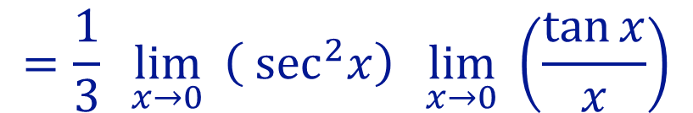


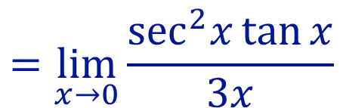
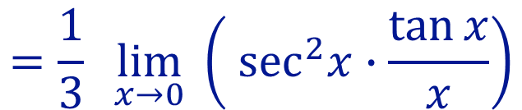
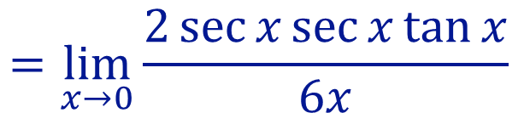
Example 2
$$=\lim_{x→0}{\frac{2\sec{x}\sec{x\tan{x}}}{6x}}$$
$$=\lim_{x→0}{\frac{\sec^{2}x\tan{x}}{3x}}$$
$$=\frac{1}{3}\lim_{x→0}{ \left(\sec^{2}x∙\frac{\tan{x}}{x}\right)}$$
$$=\frac{1}{3}\lim_{x→0}{ \left(\sec^{2}x\right)}\lim_{x→0}{ \left(\frac{\tan{x}}{x}\right)}$$

Slide 16
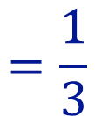
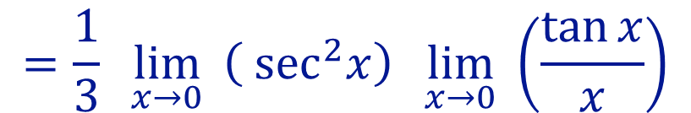



Example 2
$$=\frac{1}{3}\lim_{x→0}{ \left(\sec^{2}x\right)}\lim_{x→0}{ \left(\frac{\tan{x}}{x}\right)}$$
$$=\frac{1}{3}$$
$${ \left(\sec^{2}0\right)}$$
$$∙1$$
$$=\frac{1}{3}$$

Slide 17



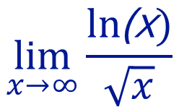

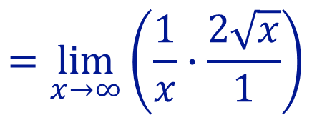
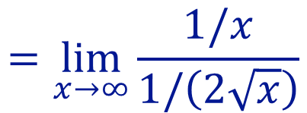

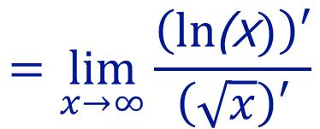

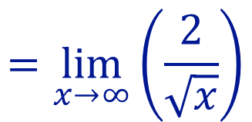

Example 3
$$\lim_{x→∞}{\frac{ln\text{(}\text{x})}{\sqrt{x}}}$$
$$=\lim_{x→∞}{\frac{\left(ln\text{(}\text{x})\right)′}{\left(\sqrt{x}\right)′}}$$
$$\left(\frac{∞}{∞}\right)$$
$$=\lim_{x→∞}{\frac{1/x}{1/\left(2\sqrt{x}\right)}}$$
$$=\lim_{x→∞}\left(\frac{1}{x}∙\frac{2\sqrt{x}}{1}\right)$$
$$=\lim_{x→∞}\left(\frac{2}{\sqrt{x}}\right)$$
$$=0$$

Slide 18














Slide 19
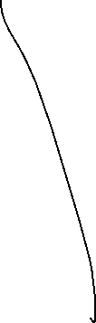
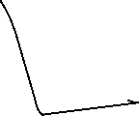









Slide 20













Slide 21




Slide 22




Slide 23














Slide 24

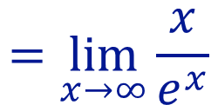



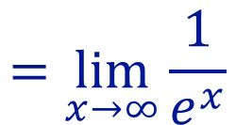
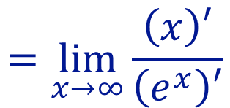
Example 4
$$\lim_{x→∞}{xe^{−x}}$$
$$\left(∞∙0\right)$$
$$=\lim_{x→∞}{\frac{x}{e^{x}}}$$
$$\left(\frac{∞}{∞}\right)$$
$$=\lim_{x→∞}{\frac{\left(x\right)′}{\left(e^{x}\right)′}}$$
$$=\lim_{x→∞}{\frac{1}{e^{x}}}$$
$$=0$$

Slide 25











Example 5
$$\lim_{x→0^{+}}{ x^{x}}$$
$$\left(0^{0}\right)$$
$$=\lim_{x→0^{+}}{e^{\ln{x^{x}}}}$$
$$=\lim_{x→0^{+}}{e^{x\ln{x}}}$$
$$=\lim_{x→0^{+}}{e^{\frac{\ln{x}}{1/x}}}$$
$$={e^{\lim_{x→0^{+}}{\frac{\ln{x}}{1/x}}}}$$
$$\left(\frac{−∞}{∞}\right)$$

Slide 26





Example 5
$$=e^{\lim_{x→0^{+}}{\frac{\ln{x}}{1/x}}}$$
$$\left(\frac{−∞}{∞}\right)$$
$$=e^{\lim_{x→0^{+}}{\frac{\left(\ln{x}\right)′}{\left(1/x\right)′}}}$$
$$=e^{\lim_{x→0^{+}}{\frac{\left(1/x\right)}{\left(−1/x^{2}\right)}}}$$
$$=e^{\lim_{x→0^{+}}{\frac{1}{x}∙\left(\frac{x^{2}}{−1}\right)}}$$

Slide 27




Example 5
$$=e^{\lim_{x→0^{+}}{\frac{1}{x}∙\left(\frac{x^{2}}{−1}\right)}}$$
$$=e^{\lim_{x→0^{+}}\left(−x\right)}$$
$$=e^{0}$$
$$=1$$

Slide 28






Slide 29







Example 6
$$\lim_{x→∞}{{\left(1+\frac{12}{x}\right)}^{x}}$$
$$\left(1^{∞}\right)$$
$$=\lim_{x→∞}{e^{\ln{{\left(1+\frac{12}{x}\right)}^{x}}}}$$
$$=\lim_{x→∞}{e^{\operatorname{xln}\left(1+\frac{12}{x}\right)}}$$
$$=e^{\lim_{x→∞}\frac{\ln\left(1+\frac{12}{x}\right)}{1/x}}$$
$$\left(\frac{0}{0}\right)$$

Slide 30






















Example 6
$$=e^{\lim_{x→∞}\frac{{\left(\ln\left(1+\frac{12}{x}\right)\right)}^{′}}{{\left(1/x\right)}^{′}}}$$
$$=e^{\lim_{x→∞}\frac{\frac{−12}{x^{2}}}{1+\frac{12}{x}} ∙ \frac{1}{\left(\frac{−1}{x^{2}}\right)}}$$
$$=e^{\lim_{x→∞}\frac{12}{1+\frac{12}{x}}}$$

Slide 31



Example 6
$$=e^{\lim_{x→∞}\frac{12}{1+\frac{12}{x}}}$$
$$=e^{\frac{12}{1+0}}$$
$$=e^{12}$$

Slide 32







Example 7
$$\lim_{x→∞}{ x^{1/x}}$$
$$\left(∞^{0}\right)$$
$$=\lim_{x→∞}{e^{\ln{x^{1/x}}}}$$
$$=\lim_{x→∞}{e^{\frac{\ln{x}}{x}}}$$
$$=e^{\lim_{x→∞}{\frac{\ln{x}}{x}}}$$
$$\left(\frac{∞}{∞}\right)$$
$$=e^{\lim_{x→∞}{\frac{\left(\ln{x}\right)′}{\left(x\right)′}}}$$

Slide 33





Example 7
$$=e^{\lim_{x→∞}{\frac{\left(\ln{x}\right)′}{\left(x\right)′}}}$$
$$=e^{\lim_{x→∞}{\frac{1/x}{1}}}$$
$$=e^{\frac{0}{1}}$$
$$=e^{0}$$
$$=1$$

Slide 34





Example 8
$$\lim_{x→0^{+}}{ \left(\frac{1}{x}−\frac{1}{\tan^{−1}{x}}\right)}$$
$$\left(∞−∞\right)$$
$$\left(\frac{0}{0}\right)$$
$$=\lim_{x→0^{+}}\left(\frac{\tan^{−1}{x−x}}{x\tan^{−1}{x}}\right)$$
$$=\lim_{x→0^{+}}\frac{{\left(\tan^{−1}{x−x}\right)}^{′}}{{\left(x\tan^{−1}{x}\right)}^{′}}$$

Slide 35



Example 8
$$=\lim_{x→0^{+}}\frac{{\left(\tan^{−1}{x−x}\right)}^{′}}{{\left(x\tan^{−1}{x}\right)}^{′}}$$
$$=\lim_{x→0^{+}}\frac{\frac{1}{1+x^{2}}−1}{\tan^{−1}{x}+\frac{x}{1+x^{2}}}$$
$$=\lim_{x→0^{+}}\frac{1−1−x^{2}}{{\left(1+x^{2}\right)tan}^{−1}{x}+x}$$

Slide 36













Example 8
$$=\lim_{x→0^{+}}\frac{\left(−x^{2}\right)′}{{\left({\left(1+x^{2}\right)tan}^{−1}{x}+x\right)}^{′}}$$
$$=\lim_{x→0^{+}}\frac{−2x}{2x\tan^{−1}{x}+1+1}$$
$$=\frac{0}{0+1+1}$$
$$=0$$

Slide 37
The Mean Value Theorem
Copyright © Cengage Learning. All rights reserved.

Slide 38
The Mean Value Theorem
We will see that many of the results depend on one central fact, which is called the Mean Value Theorem.

Slide 39
Rolle’s Theorem and Mean Value Theorem

Slide 40










Rolle’s Theorem and Mean Value Theorem
$$y$$
$$P\left(c,f\left(c\right)\right)$$
${m=f}^{′}\left(c\right)$=0
$$f\left(a\right)=f\left(b\right)$$
$$A\left(a,f\left(a\right)\right)$$
$$B\left(b,f\left(b\right)\right)$$
$$x$$
$$a$$
$$c$$
$$b$$

Slide 41









Rolle’s Theorem and Mean Value Theorem
$$y$$
$${m=f}^{′}\left(c\right)$$
$$P\left(c,f\left(c\right)\right)$$
$$f\left(b\right)$$
$$B\left(b,f\left(b\right)\right)$$
$$m=\frac{f\left(b\right)−f(a)}{b−a}$$
$$f\left(a\right)$$
$$A\left(a,f\left(a\right)\right)$$
$$x$$
$$a$$
$$c$$
$$b$$

Slide 42




Rolle’s Theorem and Mean Value Theorem
Rolle’s Theorem | Mean Value Theorem
Let f be a function that satisfies the following hypotheses:
Let f be a function that satisfies the following hypotheses:
1. f is continuous on the closed interval [a, b].
1. f is continuous on the closed interval [a, b].
2. f is differentiable on the open interval (a, b)..
2. f is differentiable on the open interval (a, b)..
3. f (a) = f (b)
Then there is a number c in (a, b) such that
$$f^{′}\left(c\right)=\frac{f\left(b\right)−f(a)}{b−a}$$
Equivalently, $f\left(b\right)=f(a){+\left(b−a\right)f}^{′}\left(c\right)$
Then there is a number c in (a, b) such that
$$f^{′}\left(c\right)=0$$

Slide 43




Rolle’s Theorem
Figure 1 shows the graphs of four functions which illustrates the Rolle’s theorem.
(a)
(b)
(c)
(d)
Figure 1

Slide 44
Rolle’s Theorem
In each case it appears that there is at least one point (c, f (c)) on the graph where the tangent is horizontal and therefore
Thus Rolle’s Theorem is plausible.

Slide 45


The Mean Value Theorem
We can see that this theorem is reasonable by interpreting it geometrically. Figures 3 and 4 show the points A (a, f (a)) and B (b, f (b)) on the graphs of two differentiable functions.
Figure 3
Figure 4

Slide 46
The Mean Value Theorem
The slope of the secant line AB is
which is the same expression as on the right side of Equation 1.

Slide 47
The Mean Value Theorem
Since
is the slope of the tangent line at the point (c, f (c)), the Mean Value
Theorem, in the form given by Equation 1, says that there is at least one point P (c, f (c)) on the graph where the slope of the tangent line is the same as the slope of the secant line AB.
In other words, there is a point P where the tangent line is parallel to the secant line AB.

Slide 48
Example 2
Prove that the equation
has exactly one real solution.
Solution:
First we use the Intermediate Value Theorem to show that a root exists.
Let
Then f (0) = −1 < 0 and f (1) = 1 > 0.
Since f is a polynomial, it is continuous, so the Intermediate Value Theorem states that there is a number c between 0 and 1 such that f (c) = 0.
Thus the given equation has a root.

Slide 49
Example 2 – Solution (1 of 2)
To show that the equation has no other real solution, we use Rolle’s Theorem and argue by contradiction.
Suppose that it had more than one solution.
Suppose that a and b are two roots for this equaiton. Then f (a) = 0 = f (b) and, since f is a polynomial, it is differentiable on (a, b) and continuous on [a, b].
Thus, by Rolle’s Theorem, there is a number c between a and b such that

Slide 50



Example 2 – Solution (2 of 2)
But
$$f^{′}\left(c\right)=3c^{2}+1$$
$$≥1$$
so
$$f^{′}\left(c\right)$$
can never be 0.
This gives a contradiction.
Therefore the equation can’t have two real roots.

Slide 51
Example 3
To illustrate the Mean Value Theorem with a specific function, let’s consider
Since f is a polynomial, it is continuous and differentiable for all x, so it is certainly continuous on [0, 2] and differentiable on (0, 2).
Therefore, by the Mean Value Theorem, there is a number c in (0, 2) such that

Slide 52
Example 3
Now f (2) = 6,
f (0) = 0, and
so this equation becomes
which gives
But c must lie in (0, 2), so

Slide 53

Example 3 (3 of 3)
Figure 6 illustrates this calculation:
the tangent line at this value of c is parallel to the secant line O B.
Figure 6

Slide 54
Example 5
Suppose that f (0) = −3 and
for all values of x. How large can f(2)
possibly be?
Solution:
We are given that f is differentiable (and therefore continuous) everywhere.
In particular, we can apply the Mean Value Theorem on the interval [0, 2]. There exists a number c such that

Slide 55
Example 5 – Solution
So
We are given that
for all x, so in particular we know that
Multiplying both sides of this inequality by 2, we have
The largest possible value for f(2) is 7.

Slide 56
Applications of The Mean Value Theorem
The Mean Value Theorem can be used to establish some of the basic facts of differential calculus.
One of these basic facts is the following theorem.
Theorem If
for all x in an interval (a, b), then f is constant on (a, b).
Corollary If
for all x in an interval (a, b), then f − g is constant on
(a, b); that is, f (x) = g(x) + c where c is a constant.

Slide 57
Applications of The Mean Value Theorem
Note
Care must be taken in applying Theorem 5. Let
The domain of f is
for all x in D. But f is obviously not
a constant function.
This does not contradict Theorem 5 because D is not an interval.

Slide 58
Newton’s Method
Copyright © Cengage Learning. All rights reserved.

Slide 59
Newton’s Method (1 of 8)
Suppose that a car dealer offers to sell you a car for $18,000 or for payments of $375 per month for five years. You would like to know what monthly interest rate the dealer is, in effect, charging you.
To find the answer, you have to solve the equation
We can find an approximate solution to Equation 1 by plotting the left side of the equation and finding the x-intercepts.

Slide 60

Newton’s Method (2 of 8)
Using a graphing calculator (or computer), and after experimenting with viewing rectangles, we produce the graph in Figure 1.
Figure 1
We see that in addition to the solution x = 0, which doesn’t interest us, there is a solution between 0.007 and 0.008. Zooming in that the x-intercept is approximately 0.0076.
If we need more accuracy than graphing provides, we can use a calculator or computer algebra system to solve the equation numerically.

Slide 61
Newton’s Method (3 of 8)
If we do so, we find that the solution, correct to nine decimal places, is 0.007628603.
How do these devices solve equations? They use a variety of methods, but most of them make some use of Newton’s method, also called the Newton-Raphson method.
We will explain how this method works, partly to show what happens inside a calculator or computer, and partly as an application of the idea of linear approximation.

Slide 62

Newton’s Method (4 of 8)
The geometry behind Newton’s method is shown in Figure 2, where the solution that we are trying to find is labeled r in the figure.
Figure 2
We start with a first approximation x₁, which is obtained by guessing, or from a rough sketch of the graph of f, or from a computer-generated graph of f.

Slide 63
Newton’s Method (5 of 8)
Consider the tangent line L to the curve y = f (x) at the point (x₁, f (x₁)) and look at the x-intercept of L, labeled x₂.
The idea behind Newton’s method is that the tangent line is close to the curve and so its x-intercept, x₂, is close to the x-intercept of the curve (namely, the root r that we are seeking). Because the tangent is a line, we can easily find its x-intercept.
To find a formula for x₂ in terms of x₁ we use the fact that the slope of L is
so its equation is

Slide 64
Newton’s Method (6 of 8)
Since the x-intercept of L is x₂, we know that the point (x₂, 0) is on the line, and so
If
we can solve this equation for x₂:
We use x₂ as a second approximation to r.
Next we repeat this procedure with x₁ replaced by the second approximation x₂, using the tangent line at (x₂, f (x₂)).

Slide 65

Newton’s Method (7 of 8)
This gives a third approximation:
If we keep repeating this process, we obtain a sequence of approximations x₁, x₂, x₃, x₄, . . . as shown in Figure 3.
Figure 3

Slide 66
Newton’s Method (8 of 8)
In general, if the nth approximation is x_{n} and
then the next
approximation is given by
If the numbers x_{n} become closer and closer to r as n becomes large, then we say that the sequence converges to r and we write

Slide 67
Example 1
Starting with x₁ = 2, find the third approximation x₃ to the solution of the equation
Solution:
We apply Newton’s method with.
Newton himself used this equation to illustrate his method and he chose x₁ = 2 after some experimentation because f\(1) = −6, f (2) = −1, and f (3) = 16.

Slide 68
Example 1 – Solution (1 of 2)
Equation 2 becomes
With n = 1 we have

Slide 69
Example 1 – Solution (2 of 2)
Then with n = 2 we obtain
It turns out that this third approximation x₃ ≈ 2.0946 is accurate to four decimal places.

Slide 70

Example 1
Find all solutions of the equation correct to two decimal places.
Solution:
We apply Newton’s method with.
$$f\left(x\right)=x^{3}−9x^{2}−4 and f^{′}\left(x\right)=3x^{2}−18x$$
From the graph it is clear that there is only one root near 10. We will take $x_{1}=9$

Slide 71
Example 1 – Solution (1 of 2)
Equation 2 becomes
$$x_{n+1}=x_{n}−\frac{f\left(x_{n}\right)}{f^{′\left(x_{n}\right)}}=x_{n}−\frac{x_{n}^{3}−9x_{n}^{2}−4}{{3x}_{n}^{2}−18x_{n}}$$
With n = 1 we have
$$x_{2}=x_{1}−\frac{f\left(x_{1}\right)}{f^{′}\left(x_{1}\right)}=x_{1}−\frac{x_{1}^{3}−9x_{1}^{2}−4}{{3x}_{1}^{2}−18x_{1}}$$
$$=9−\frac{9^{3}−9∙9^{2}−4}{3∙9^{2}−18∙9}$$
$$=9.049382716$$

Slide 72
Example 1 – Solution (2 of 2)
$$x_{2} =9.04938271$$
$$x_{3}=x_{2}−\frac{x_{2}^{3}−9x_{2}^{2}−4}{{3x}_{2}^{2}−18x_{2}}=9.04885102$$
$$x_{4}=x_{3}−\frac{x_{3}^{3}−9x_{3}^{2}−4}{{3x}_{3}^{2}−18x_{3}}=9.04885096$$
$$x_{5}=x_{4}−\frac{x_{4}^{3}−9x_{4}^{2}−4}{{3x}_{4}^{2}−18x_{4}}=9.04885096$$

